Slide 1
CSCI 570 Exam 1 Review

Slide 2
BFS and DFS
TA: Ala

Slide 3
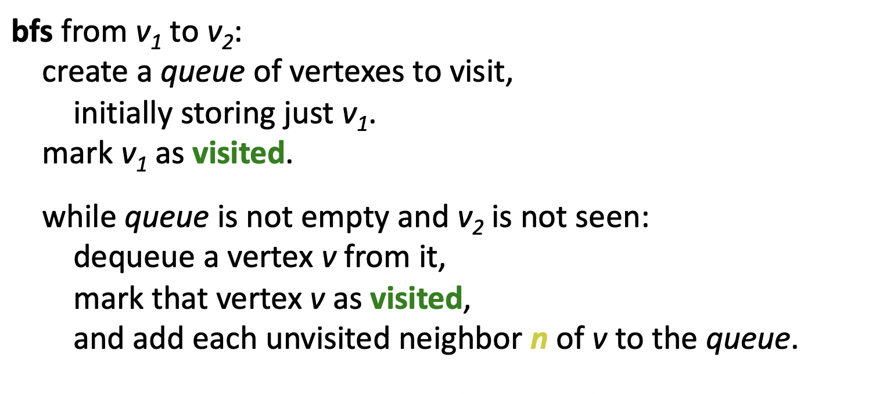
BFS
Time Complexity: O(V+E)

Slide 4
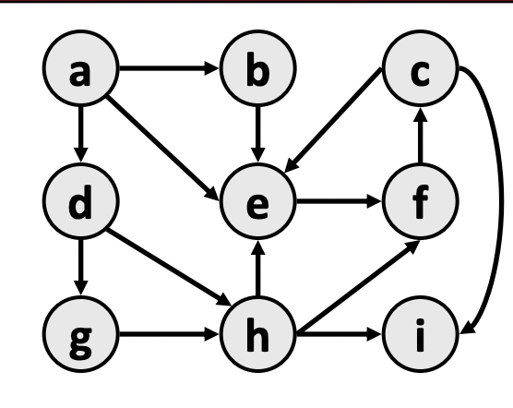
Question: BFS traversal of following graph.
a->b (since e is already visited we stop)
a->d->g (since h is already visited we stop)
->h->i (since e and i are already visited)
a->e->f->c

Slide 5
Some Observations
optimality:
– always finds the shortest path (fewest edges).
– in unweighted graphs, finds optimal cost path.
– In weighted graphs, not always optimal cost.
retrieval: harder to reconstruct the actual sequence of vertices or edges in the path once you find it
– conceptually, BFS is exploring many possible paths in parallel, so it's not easy to store a path array/list in progress
– solution: We can keep track of the path by storing predecessors for each vertex (each vertex can store a reference to a previous vertex).

Slide 6
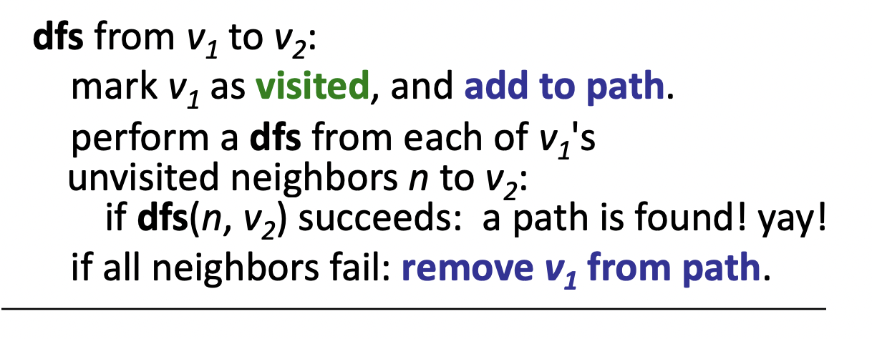
DFS
• Depth-first search (DFS): Finds a path between two vertices by exploring each possible path as far as possible before backtracking.
– Often implemented recursively.
– Many graph algorithms involve visiting or marking vertices.
– Time Complexity: O(V+E)

Slide 7
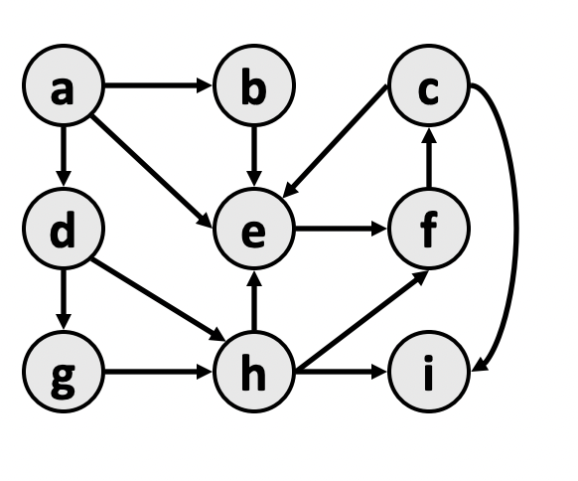
Question: Find a path from a to h
a->e->f->c->i
Backtrack to c, no more unvisited neighbors
Backtrack to f, no more unvisited neighbors
Backtrack to e, no more unvisited neighbors
Backtrack to a, univisited neighbors b and d
a->d->g->h
Observation: we could also go from d->h and that would lead to shortest path. But DFS does not guarantee shortest path, but it guarantees if path exists or not.

Slide 8
Greedy
TA: Ala

Slide 9
T/F questions
A greedy algorithm always makes the choice that looks best at the moment.
Answer: True
2 min

Slide 10
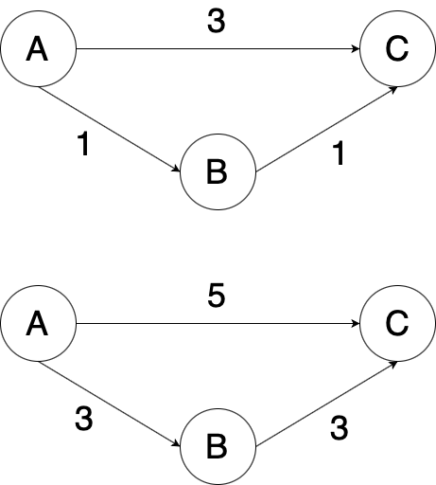
T/F questions
The shortest path between two points in a graph will not change if the weight of each edge is increased by an identical number.
Answer: False
2 min

Slide 11
T/F questions
Gale Shapley algorithm is based on greedy technique.
Answer: True
2 min

Slide 12
Problem 1
For a graph G = (V, E), a vertex cover of G is a set of vertices that includes at least one endpoint of each edge of G. Assuming our graph G is a tree, find an algorithm that finds a minimum vertex cover of G.
4 min

Slide 13
Solution 1
Let S be the set of vertices that will be the vertices we return. If our graph G has no vertices or only 1 vertex, return S. Otherwise, add all vertices 1 layer above all our leaf vertices in the tree to S, and remove the vertices and its adjacent edges from G, as well as the leaf vertices. Recursively apply this step until we end up with 1 or no vertices in G. Return S. This is optimal because we have to cover the leaf edges regardless, so our cover will always either include the leaf node itself or its parent. If we include its parent, we cover just as much if not more than if we select the leaf node. The problem then reduces to a vertex cover for a subset of the original tree. This subset is smaller than the one we would have gotten from choosing the leaf node, and a vertex cover of tree is at least as large as the vertex cover of a subset of it.

Slide 14

Problem 2
Given an array of distinct integers A = [a₁, a₂, …, a_{n}] and a sequence p of numbers p = [1, 2, …, n], rearrange the numbers in p such that is minimized.
4 min

Slide 15
Solution 2
Consider 2 real numbers ai and aj, and 2 other real numbers, pi and pj, where ai < aj and pi < pj. WLOG, assume that all 4 of these numbers are distinct. There are 6 possible orderings given these constraints: ai < aj < pi < pj, ai < pi < aj < pj, ai < pi < pj < aj, pi < ai < aj < pj, pi < ai < pj < aj, and pi < pj < ai < aj. For each of these cases, we want to show that |ai - pi| + |aj - pj| ≤ |ai - pj| + |aj - pi|, which basically means that we cannot get a smaller distance if we exchange elements pi and pj. Therefore if we have ai < aj if and only if pi < pj for all i, j, we will have the minimum distance. We can store the index of the elements in A in a hashmap h. We then sort A and pair it with p, and reorder p according to indices of h. Since our algorithm produces elements ai and pi with these properties, our algorithm produces a minimum distance.

Slide 16
In the previous proof, we left out details about showing |ai - pi| + |aj - pj| ≤ |ai - pj| + |aj - pi| for each of 6 cases. Here is an example of showing that this is true for the case for ai < pi < aj < pj. Define the distance between ai and pi, pi and aj, and aj and pj, as d1, d2, and d3 respectively. Then |ai - pi| + |aj - pj| = d1 + d3 ≤ d1 + 2*d2 + d3 = |ai - pj| + |aj - pi|. You can verify that the other cases are true as well.
In the exam, there will not be this much detail involved in a proof, and if there is, we will state which parts can be skipped or assumed to be true.

Slide 17
Problem 3
Given an array of meeting time intervals where intervals[i] = [start_i, end_i], find the minimum number of conference rooms required. i.e. [[0,30], [5,10], [15,20]]
Example: meeting 1: [0,30],meeting 2: [5,10], meeting 3: [15,20], minimum number of conference rooms required is 2, because meeting 2 and meeting 3 can share the same room but meeting 1 must reserve its own room.
(Hints: Greedy + priority queue )
Algorithm!
Correctness!
5 min

Slide 18
Solution 3 - Algorithm
Given an array of meeting time intervals where intervals[i] = [start_i, end_i], find the minimum number of conference rooms required. i.e. [[0,30], [5,10], [15,20]]
Algorithm:
Sort the given meetings by their start time.
Initialize a new min-heap and add the first meeting's ending time to the heap. We simply need to keep track of the ending times as that tells us when a meeting room will get free.
For every meeting room check if the minimum element of the heap i.e. the room at the top of the heap is free or not, which means we assign this meeting to the earliest-available room.
If the room is free, then we extract the topmost element and add it back with the ending time of the current meeting we are processing; If not, then we allocate a new room and add it to the heap.
After processing all the meetings, the size of the heap will tell us the number of rooms allocated. This will be the minimum number of rooms needed.
Time complexity:
O(nlogn) for sorting, N meetings * (O(1) for getMin + O(logn) for extractMin +O(logn) for insert) = O(nlogn)

Slide 19
Solution 3 - Correctness
Given an array of meeting time intervals where intervals[i] = [start_i, end_i], find the minimum number of conference rooms required. i.e. [[0,30], [5,10], [15,20]]
Proof of correctness:
Assume that the optimal solution does not assign [x1,y1] to the room of the earliest-end meeting: it assigns [x1,y1] to another free room ended in x0. If we can assign [x1,y1] to this free room, then the later meeting, [x2,y2] can also assign to the earliest-end meeting because x0<=x1<=x2, the result of both of the strategy ends with two rooms ended in y1 and y2, so our solution is the same as optimal solution, which means that this strategy is optimal.
Assume that when we assign [x1,y1], an optimal solution assigns [x2,y2] first where x1 < x2.
y1 <= x2. Then in our solution, we don’t need to assign extra meeting room, but optimal solution needs an extra room because x1 < y1 <= x2 < y2, which means that the meeting [x1,y1] cannot reuse the same meeting room in the optimal solution.
y1 > x2. Then both of solutions needs an extra room and ends with two meeting rooms, which end with y1 and y2. So optimal solution is not better than our solution.
We prove that our solution is not worse than optimal solution, hence this strategy is optimal.

Slide 20
Heaps
TA: Alireza

Slide 21
Question (T/F)
The number of binomial trees in a binomial heap with n elements is at most
O(log n).
Solution: True
2 min

Slide 22
Question (T/F)
Inserting an element into a binary min-heap takes O(1) time if the new element is
greater than all the existing elements in the min heap.
Solution: True
2 min

Slide 23
Question (T/F)
Height of a binary heap is O(n)
Solution: True
2 min

Slide 24
Question (T/F)
In a binary max-heap with n elements, the time complexity of finding the second largest element is O(1).
Solution: True
The second largest one should be the larger (or equal) one of the two children of the root node. Finding them takes time O(1). Note: it is possible that several elements have the same value including the first two layer of elements, then in this case, the largest element is equal to the second largest element, and returning one of the second layer elements is also fine.
2 min

Slide 25
Question (T/F)
The smallest element in a binary max-heap of size n can be found with at most n/2 comparisons.
True. In a max heap, the smallest element is always present at a leaf node. So we need to check for all leaf nodes for the minimum value → how many leaf nodes are there?
ceil(n/2) leaf nodes. → Therefore, we will only have to do at most n/2 comparisons.
2 min

Slide 26
Question 1 -a
A d-ary heap is like a binary heap, but instead of 2 children, nodes have d children.
(a) How would you represent a d-ary heap in an array?
4 min

Slide 27
Solution
If we know the maximum number, N, of nodes that we may store in the d-ary heap, we can allocate an array H of size N indexed by i = 1, 2, …, N.
The heap nodes will correspond to positions in H. H[1] will be the root node and for any node at position i in H, its children will be at positions d*(i-1) + 2, d*(i-1) + 3, …. d*(i-1) + d + 1, and the parent position at └ (i-2)/d ┘ + 1.
If there are n < N elements in the heap at any time, we will use the first n indices of the array to store the heap elements.

Slide 28
Question 1 - b
What is the height of a d-ary heap of n elements in terms of n and d?
4 min

Slide 29
Solution
There is 1 node at level 0 (L0), d at L1, d² at L2 and so on. Let h be the height of the d-ary heap. Then there are d^{h} nodes at the last level of the heap. Thus,
n = 1 + d + d² + d³ + ... + d^{h}
Solving this, we get
h = log_{d} (n(d−1)+1) - 1

Slide 30
Question 1 - c
Give an efficient implementation of ExtractMin. Analyze its running time in terms of
d and n.
4 min

Slide 31
Solution
Similar to the ExtractMin operation for a binary heap, for a d-ary heap with n
elements, we find the minimum (the root node) in O(1) time and to delete it, we
replace H[1] with H[n] = w. If the resulting array is not a heap, we use Heapify-up or Heapify-down to fix the heap in O(h) = O(logd n) time.

Slide 32
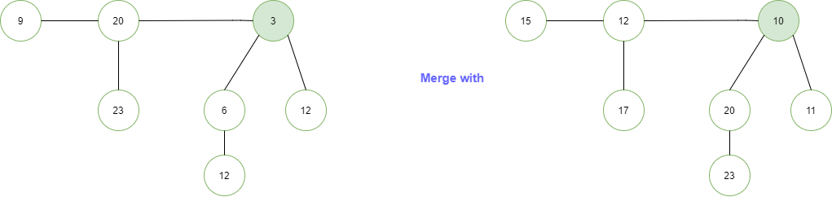
Question 2
14
4 min

Slide 33
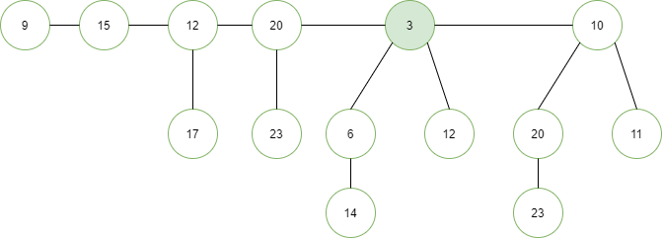
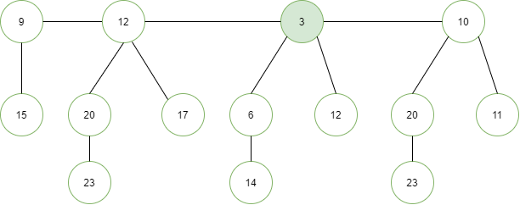

Slide 34
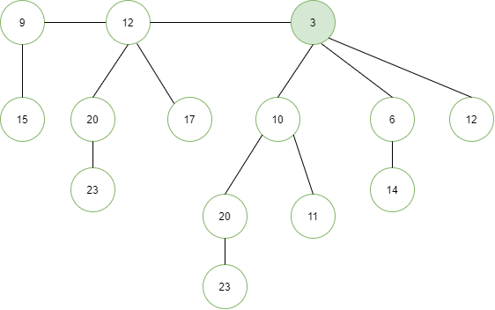

Slide 35
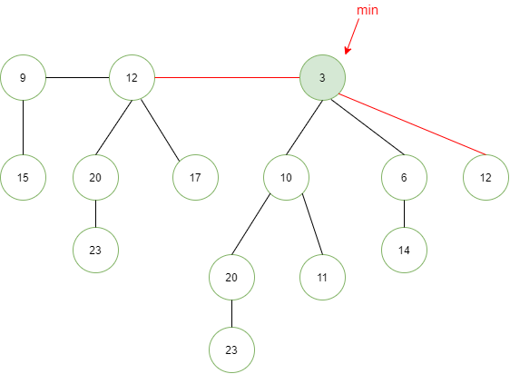
deleteMin()
4 min

Slide 36
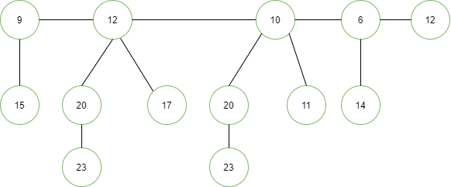

Slide 37
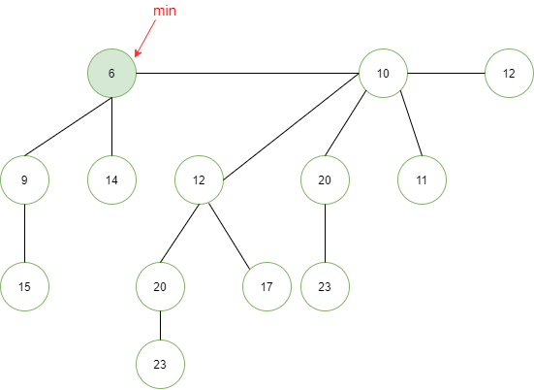

Slide 38
MST
TA: Alireza

Slide 39
MST 1
If all edge weights of a given graph is the same, then every spanning tree of that graph is minimum.
True.
Spanning tree: Any tree that covers all nodes of a graph is called a spanning tree.
2 min

Slide 40
MST 2
If the weight of each edge in a connected graph is distinct, then the graph contains exactly one unique minimum spanning tree.
True.
Proof: Suppose two MSTs T1 and T2 of G,
E = set of edges that is in either T1 or T2 but not both.
e is the min edge in E.
Suppose e is not in T2. Adding e to T2 creates a cycle. Then in this cycle, at least one edge, say f, is not in T1. Since e is the min edge in E, then w(e) <= w(f). And all edges have distinct weights, w(e) < w(f). Replacing f with e results in a new spanning tree with less weight than T1 and T2. Therefore, contradiction.
2 min

Slide 41
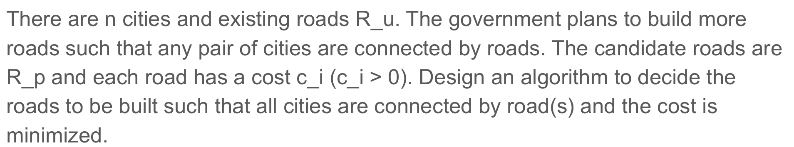
MST 3
4 min

Slide 42
MST 3
1: Construct a graph with n nodes.
2: Add R_u to the graph and set edge weight to be 0.
3: Add R_p to the graph and set edge weights to be the cost.
4: Run MST algorithm, return roads that are in both R_p and MST.
1: Get connected components of the graph with R_u.
2: Merge nodes and edges.
3: Add R_p, run MST.

